Slide 1
Data is Personal
Attitudes and Perceptions of Data Visualization in Rural Pennsylvania

Slide 2

Background
Encounters with data can be manipulated by several factors
Experience or education
Biases
Attention
Focus on people in rural settings is motivated by
The population’s absence in the visualization literature
Gaps in education, income
Literacy may impact perceptions of data visualizations

Slide 3
Which visualizations do people understand?
Visual Literacy
capability of a person “to read, comprehend, and interpret” graphs
What can cause problems?
New graphic representation without training
Lack of familiarity

Slide 4
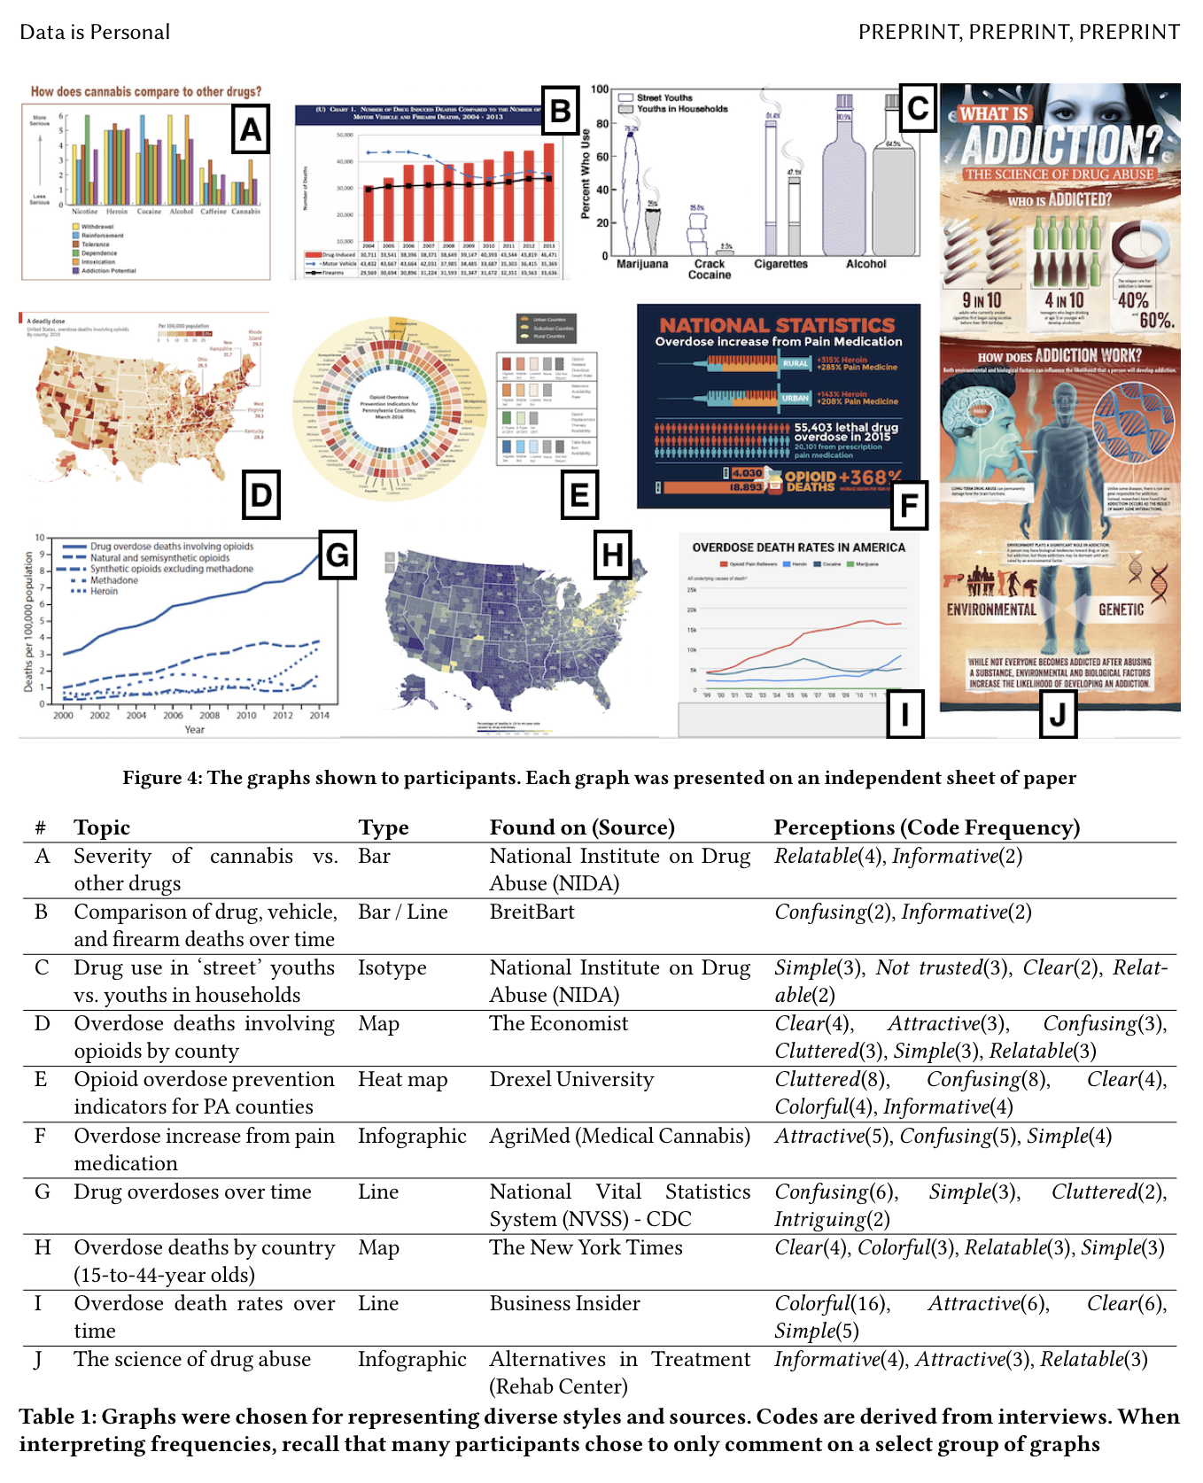
Procedure
10 different data visualizations that broadly involve the impact of drugs in the United States
Charts were chosen to represent a diverse set of features, including form, visual appeal, and source
Each chart was presented to participants in color on individual sheets of paper.

Slide 5
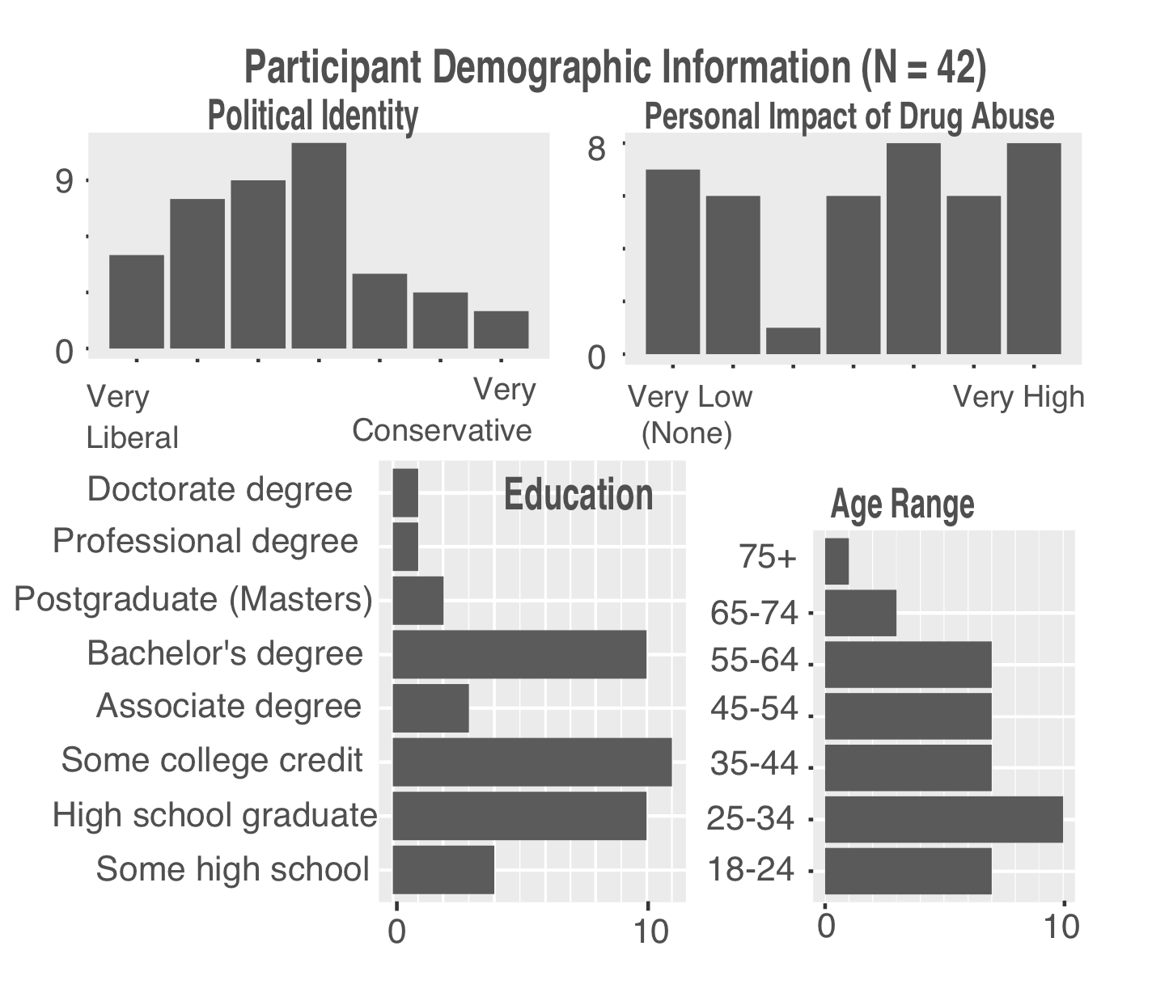
Procedure
Participants
Staff members at a local university. Participants largely identified as working in food services as cashier, line server, prep kitchen, or management.
Employees at a local construction site. Participants largely identified as working in demolition or labor.
Visitors of a local farmers market. Participants were diverse in their backgrounds and occupations.

Slide 6
Procedure
Age
School district,
Political affiliation (“very liberal”(1) to “very conservative”(7))
Familiarity with graphs and charts
Educational background
The extent to which they had been personally impacted by drugs and/or addiction

Slide 7
Procedure
Introduction and consent.
Graphs presentation and ranking.
“Based on how useful they are to you, arrange the graphs from most useful to least useful”
‘useful’ was successful in encouraging the participants to express opinions
Sources are revealed
Demographics questions (collected after the interview)

Slide 8
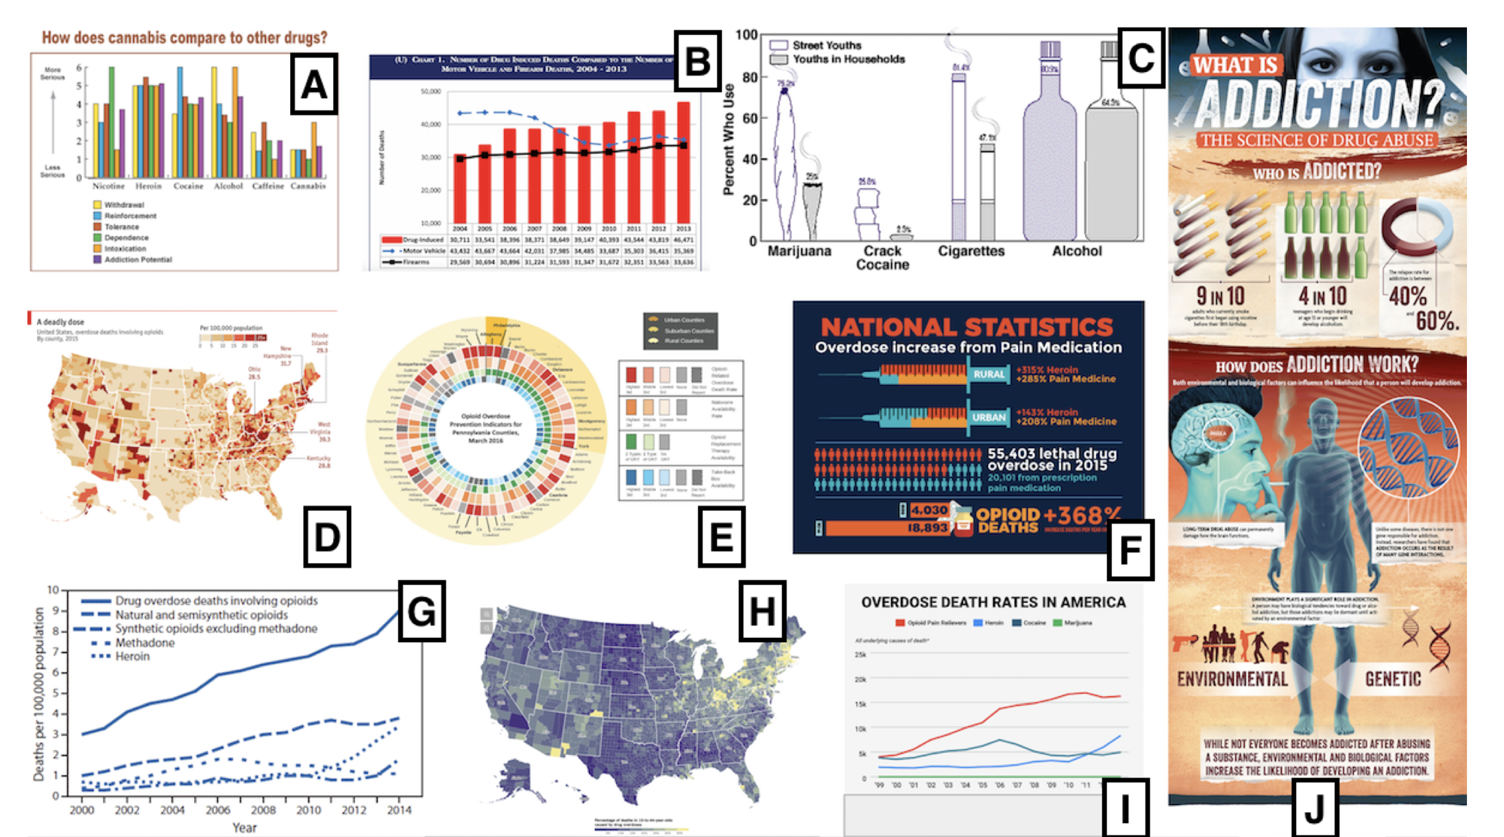
Analysis
The most common codes associated with graphs across our interviews are as follows: Colorful (29) , Confusing (29), Clear (26), Simple (26), Relatable (21), Attractive (20), Informative (19), Cluttered (17)
gravitated towards straightforward visual encodings
Simple bar graphs (Graphs A, B) and line graphs (Graph I) emerged as among our more highly ranked charts

Slide 9
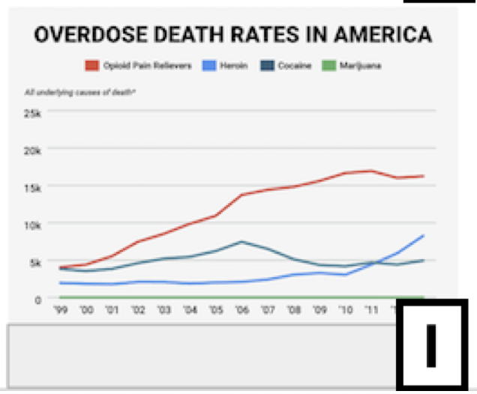
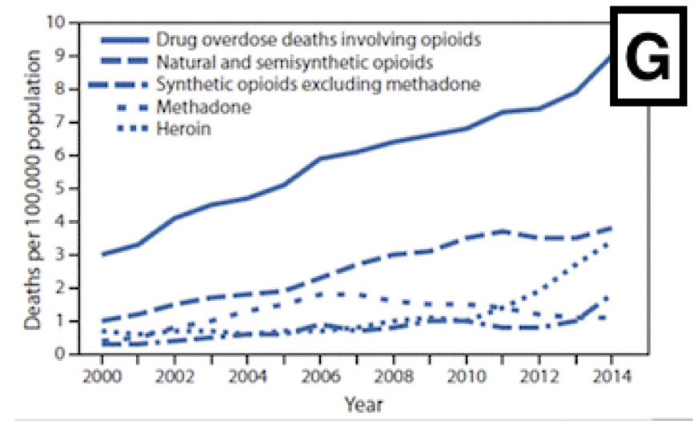

Slide 10
Graph G and I
critiques of clarity and aesthetics often blurred together for our participants
16 participants identified color as a distinguishing factor
often ambiguous as to whether color referenced general appeal or an improved visual encoding

Slide 11
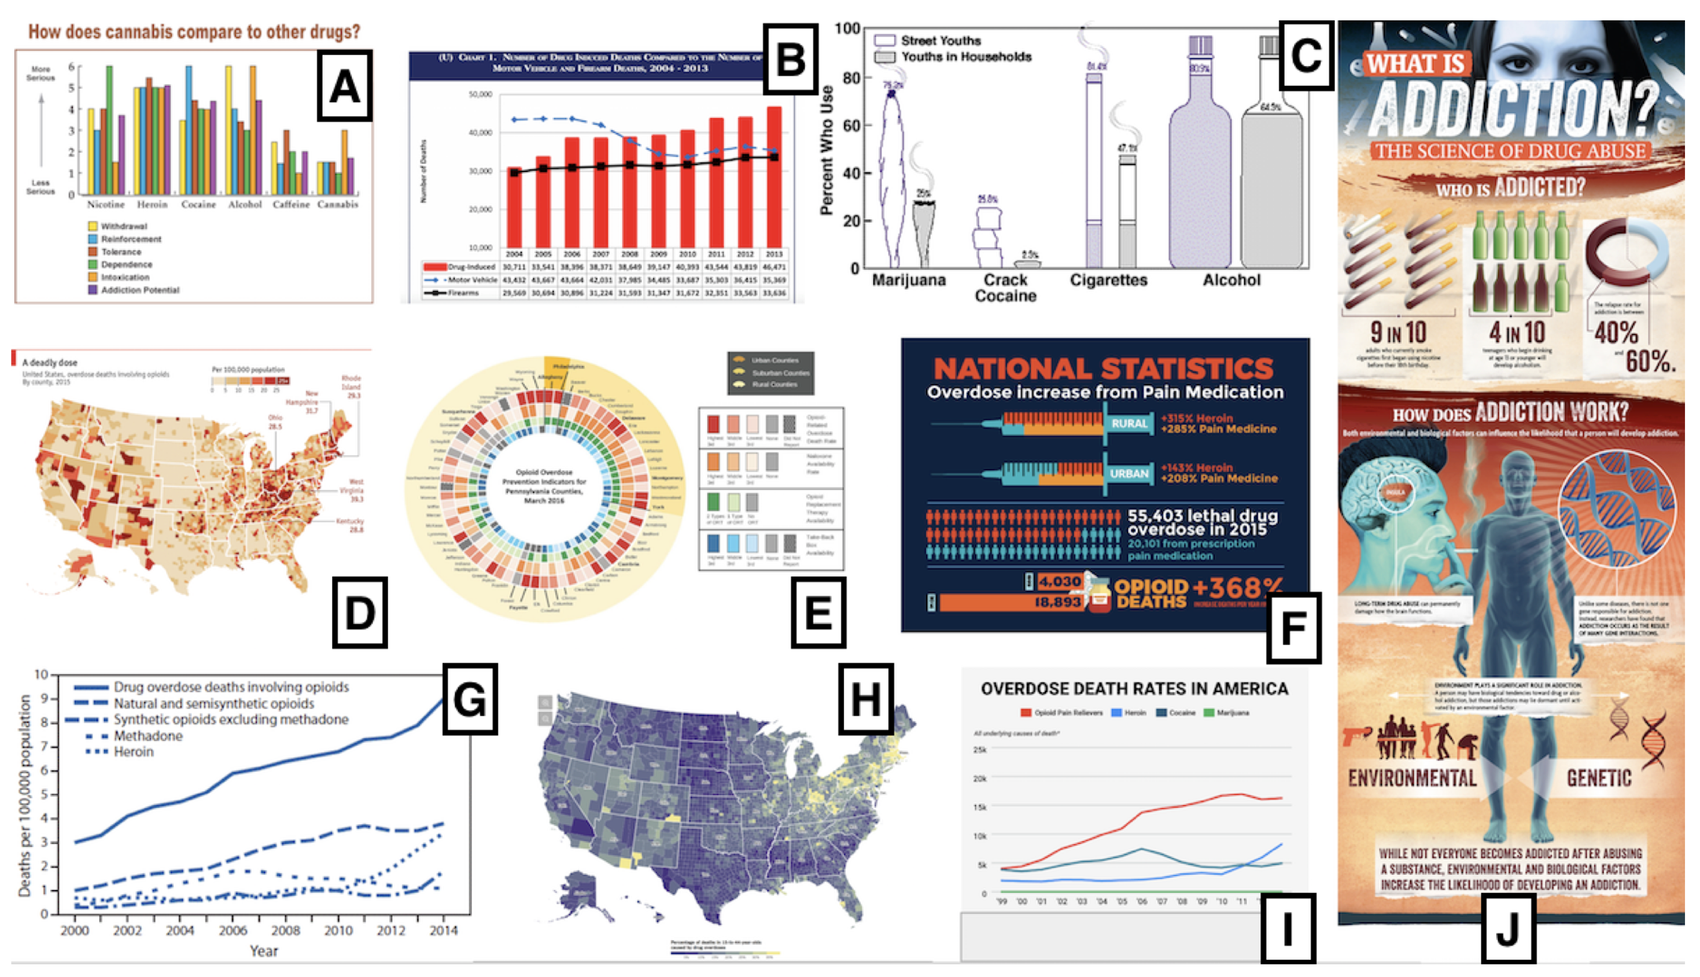
Infographics
Graph J received the most polarizing rankings of any chart
Participants who had positive feelings about infographics (Graphs F and J) found them to be clear (5), simple (5), and attractive (8)
infographics were often rated lower by older people

Slide 12
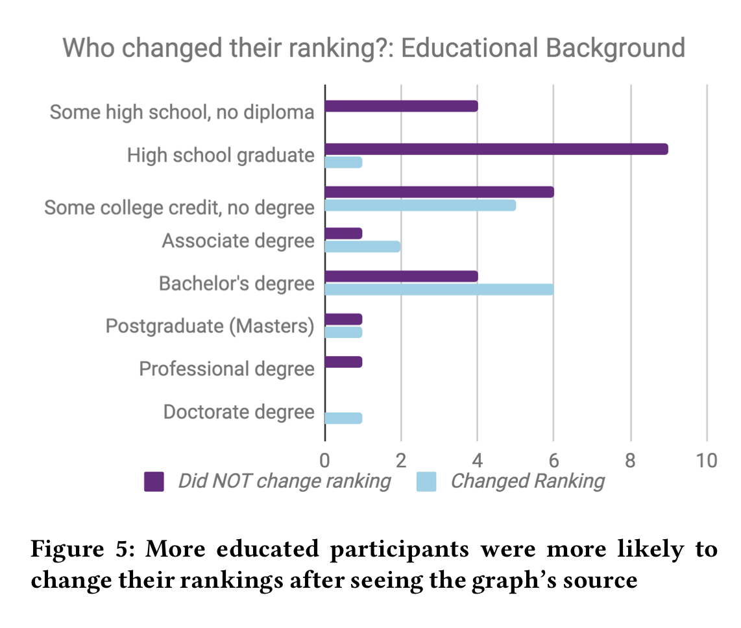
Unchanged ranking
Source is irrelevant (9): expressed that the source does not impact the data and/or presentation.
Ranked on other criteria (5): expressed that their initial ranking was based on other criteria (visuals, interest) and that criteria had not changed.
No reason(4) :could not (or was not willing to) articulate any reason for maintaining their rankings
All sources are trusted (3): perceived that all sources were equally trustworthy.

